Slide 1

Big Data Final Project
Data Reduction & Spectral Analysis of Turbulent Fields
Eugene Hoffman

Slide 2
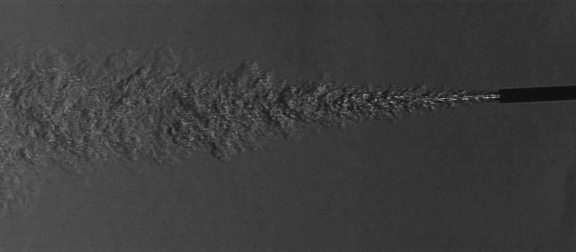
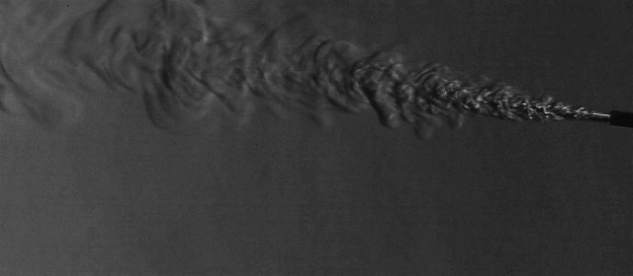
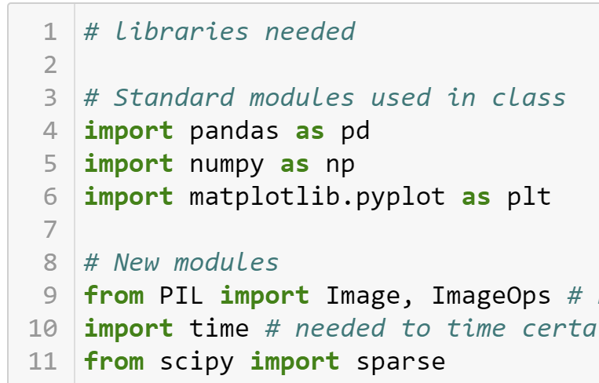
Overview
Hypothesis
Decrease Data Handling size by using frequency reduction of data
Jets of varying pressure/velocity share similar frequency content and can be correlated
Direct correlations between high frequency content and Jet pressure/velocity exists.
Data stored on Google Drive
Test 1
Test 2
Image Set | Pixel size (rows x cols) | Image Count | Data Set Size
Test 1 BG | 680 x 280 | 200 | 14 MB
Test 1 | 680 x 280 | 100,000 | 7.62 GB
Test BG | 680 x 280 | 2,000 | 343 MB
Test 2 | 680 x 280 | 150,000 | ~11 GB

Slide 3
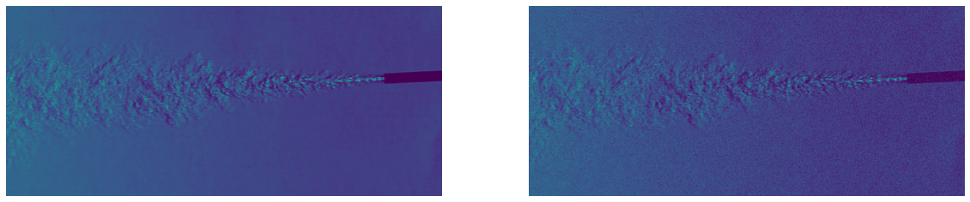
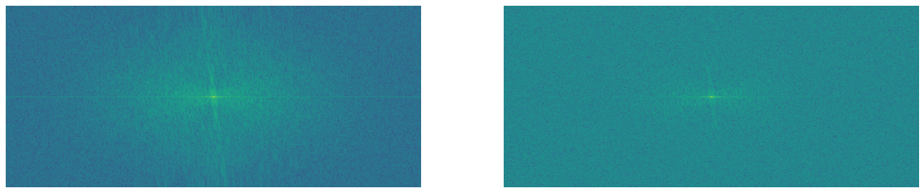
Image Quality Check
Speckled Image
Clean Image
2D FFT Magnitude of Clean image
2D FFT Magnitude of Speckled image
Norm(2D FFT Magnitude of Speckled image) - Norm(2D FFT Magnitude of Clean image) > threshold

Slide 4
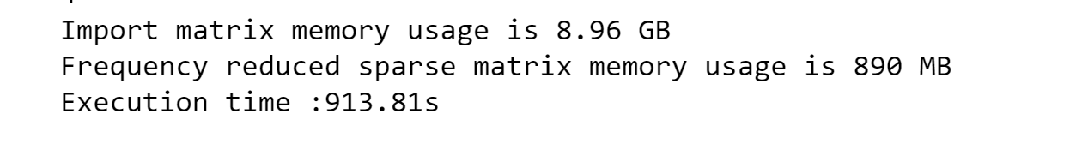

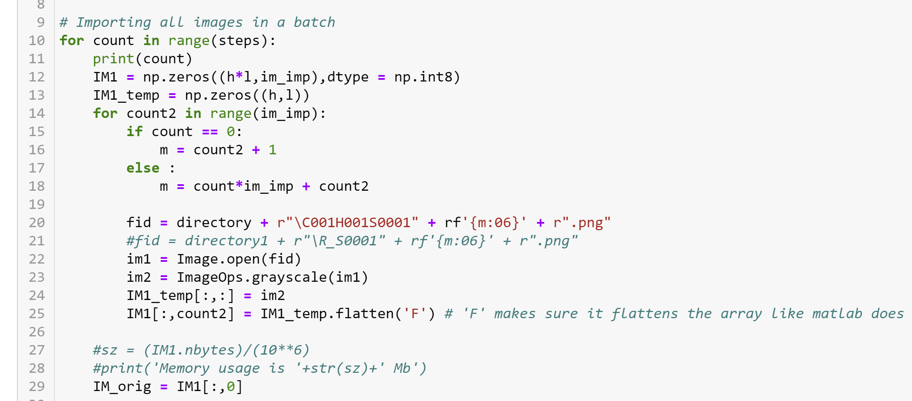
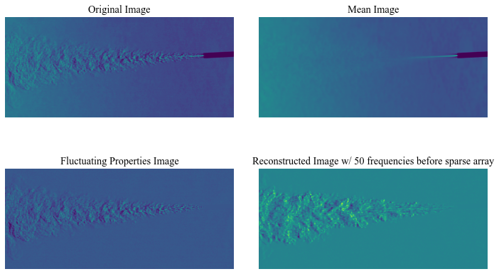
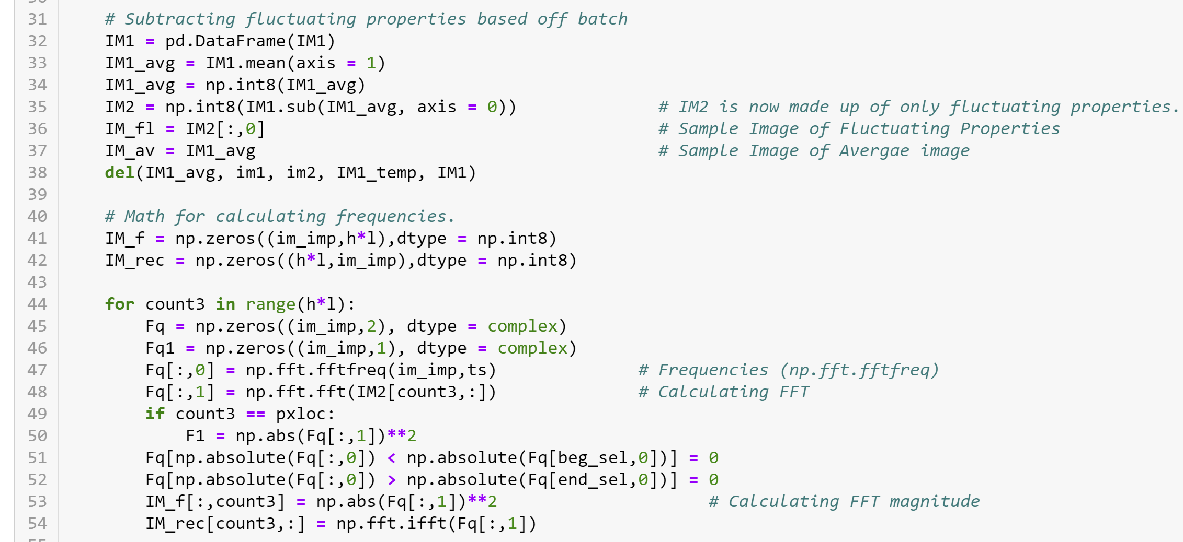
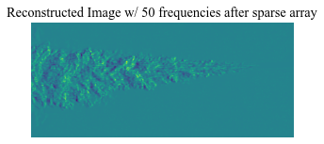
Import and Data Reduction – Goal/Hypothesis 1

Slide 5
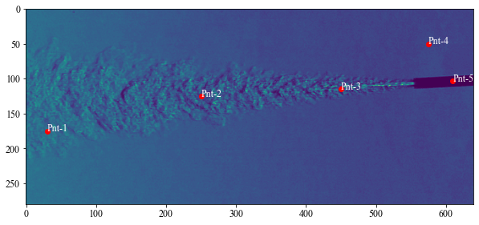
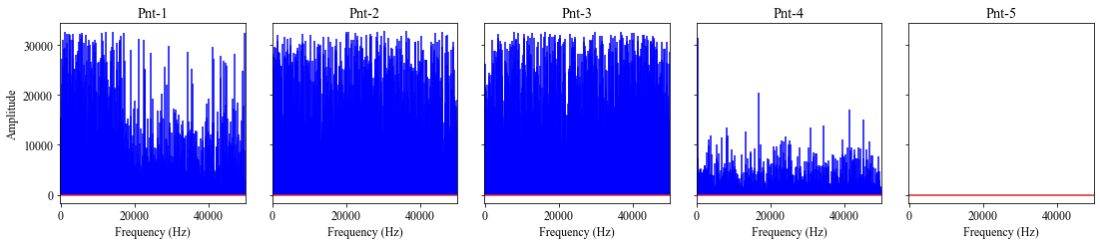
Frequency Analysis of Flow – Test 1 Goal/Hypothesis 2 & 3

Slide 6
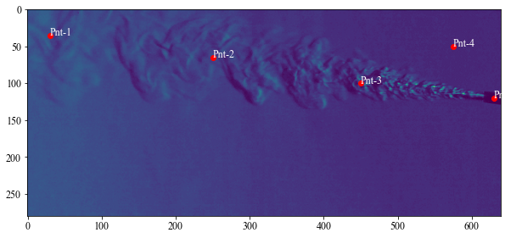
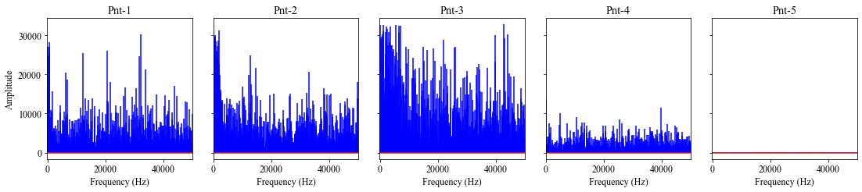
Frequency Analysis of Flow – Test 2 Goal/Hypothesis 2 & 3
Correlation of Tests
 | Test_1-Pt1 | Test_1-Pt2 | Test_1-Pt3 | Test_1-Pt4
Test_2-Pt1 | 0.034854 | 0.022765 | 0.019654 | 0.021102
Test_2-Pt2 | 0.128545 | 0.039783 | -0.027614 | 0.111134
Test_2-Pt3 | 0.194619 | 0.023648 | 0.013480 | 0.080446
Test_2-Pt4 | -0.038751 | -0.020953 | -0.039809 | 0.000972

Slide 7
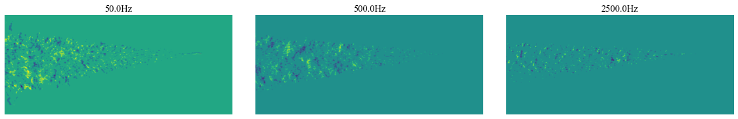
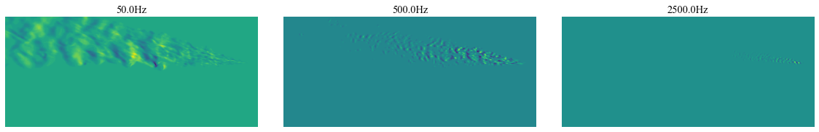
Frequency representation of the flow - Goal/Hypothesis 3
Test 1
Test 2

Slide 8
Questions??

